Slide 1
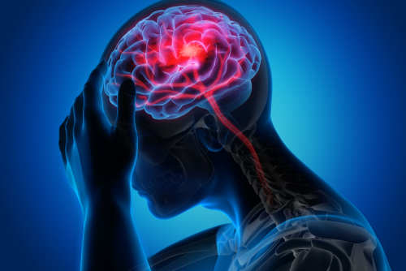
Brain Stroke Prediction
Presented By
Bharath Dharavath​
Chandana Dokkadi​
Mamatha Nenavath​
Paweena Klincharoen​
Srivalli Adigarla

Slide 2
Agenda
The impact of technology on education
Setting up a virtual learning space
Key topics discussed
in this presentation
The role of interactive technology in education
The benefits of interactive technology
Remote learning and the new normal
New trends to watch out for

Slide 3

Problem Statement
Stroke is a major cause of death and disability, and a predictive model that can identify patients who are at risk of having a stroke would be very helpful in improving patient outcomes and reducing the burden on healthcare systems. However, currently there is no accurate and efficient predictive model that can identify patients at risk of stroke with great accuracy.

Slide 4
Project Definition
Objective
Develop a predictive model for stroke using data analysis and machine learning in KNIME Analytics.​
Analyze a dataset of clinical and demographic variables to identify stroke risk factors.​
Improve patient outcomes by facilitating early detection and intervention for stroke
Identify stroke risk factors using clinical and demographic variables.​
Develop a predictive model using machine learning in KNIME Analytics.​
Evaluate model performance using various metrics and techniques.

Slide 5
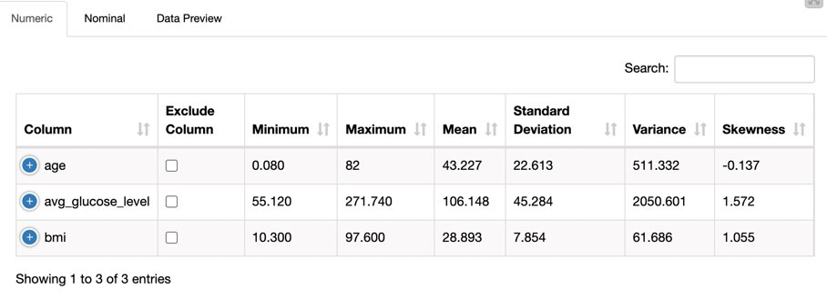
Descriptive Analysis
In this table, the average of age is around 43.227 which can be implied as middle age. We can also see that the average glucose level is around 106.148 which is a little bit higher than normal. The average of BMI is around 28.893 which falls within the overweight range.

Slide 6
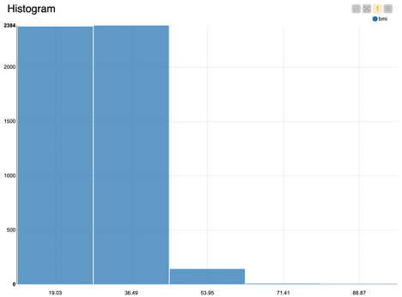
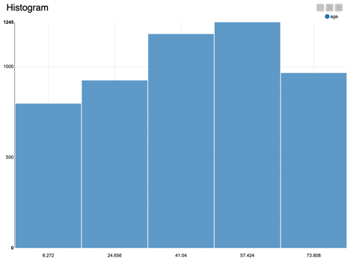
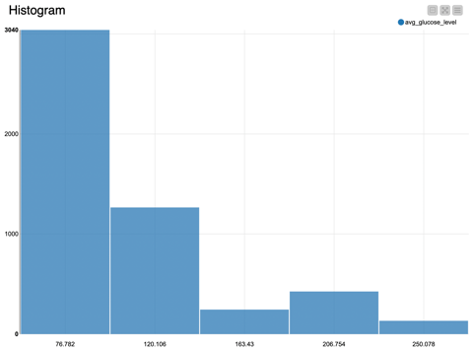
Histogram

Slide 7
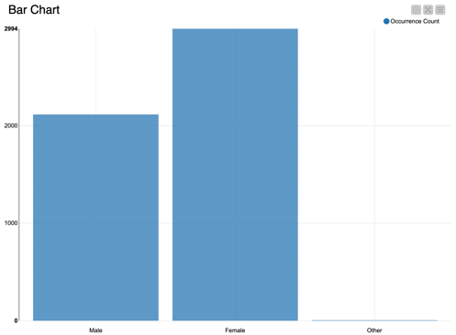
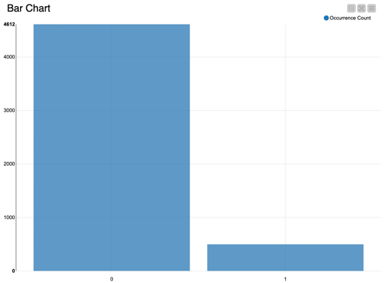
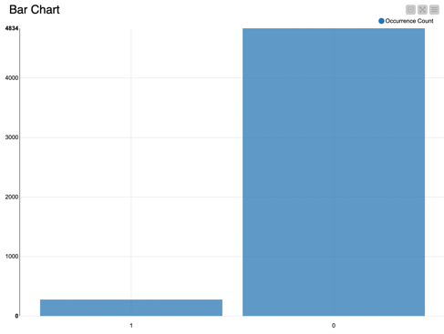
Bar Chart

Slide 8
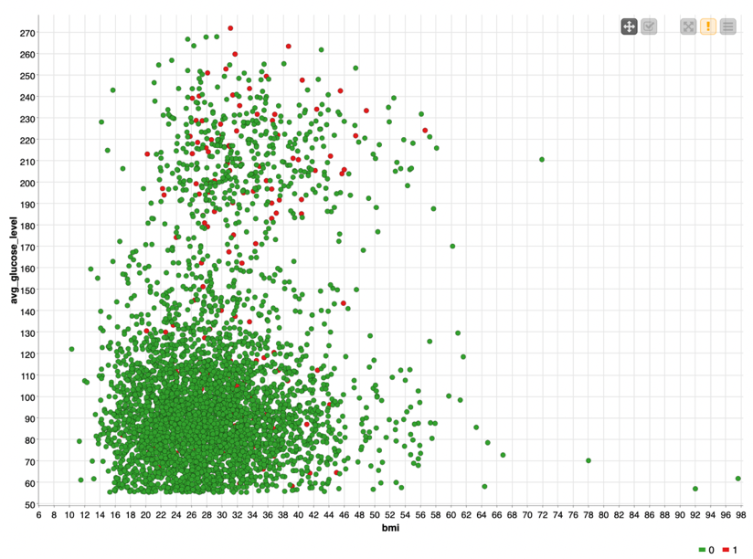
Average Glucose Level vs BMI vs Brain Stroke
This scatter plot shows people who has high glucose level and high BMI tend to have brain stroke more.

Slide 9
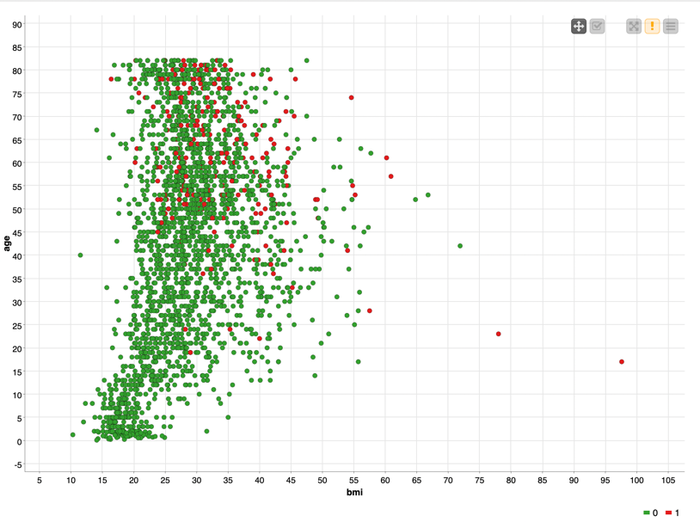
Age vs BMI vs Hypertension
This scatter plot shows people who are older and have higher BMI are likely to have high hypertension.

Slide 10
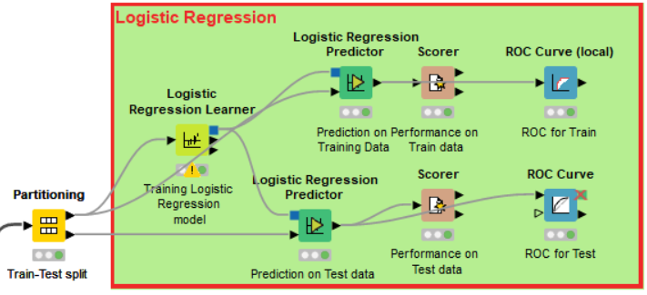
Model Building- Logistic Regression
Knime Workflow:
Logistic regression is a statistical method
commonly used for classification tasks where
the objective is to predict a binary outcome.
The target variable is “Stroke” which
gives the stroke status of the patient
whether the patient is having a brain
stroke(1) or not(0).

Slide 11
Model Building- Logistic Regression
Predict whether a patient has a brain stroke by using different independent variables.
This model can make wrong predictions as:
It predicts the patient having brain stroke(1) as (0), which means no brain stroke- FALSE NEGATIVE (Dangerous)
It predicts the non brain stroke patient(0) as brain stroke patient(1)- FALSE POSITIVE
TRAIN |  | Predicted
 |  | 1 | 0
Actual | 1 | 34(TP) | 140(FN)
 | 0 | 137(FP) | 3266(TN)
 | Accuracy | Recall | Precision | F1 Score
Train | 92.3% | 96% | 95.9% | 95.9%
Test | 92% | 96.2% | 95.7% | 95.9%
TEST |  | Predicted
 |  | 1 | 0
Actual | 1 | 12(TP) | 63(FN)
 | 0 | 56(FP) | 1402(TN)
Accuracy = TP + TN / (TP + FP + FN + TN)
Precision = TP / (TP + FP)
Recall or sensitivity = TP / (TP+FN)
Specificity = TN / (TN + FP)
F1 Score = (2 X Precision X Recall)/ (Precision + Recall)

Slide 12
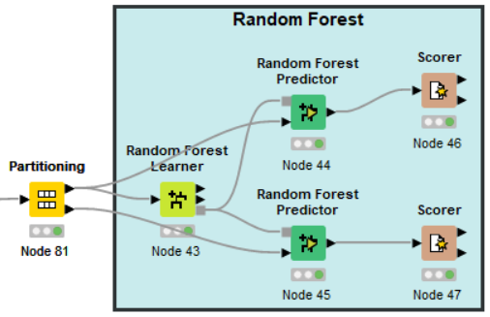
Model Building- Random Forest
Splitting the dataset:
The data that has been preprocessed is fed into a partitioning
node in KNIME, which splits it into a training set and a test set,
With a ratio of 80% for training and 20% for testing.
Model Building:
The Random Forest Learner node is used to build a Decision Tree
model on the train with the target variable “Stroke status”.
The performance of the random forest model is evaluated on
both the training and test data sets in order to assess its
effectiveness in capturing patterns in the training data and its
ability to generalize to unseen data.

Slide 13
Model Evaluation- Random Forest
Random Forest with default split criterion- Information Gain Ratio
TRAIN |  | Predicted
 |  | 1 | 0
Actual | 1 | 22(TP) | 152(FN)
 | 0 | 0(FP) | 3403(TN)
 | Accuracy | Recall | Precision | F1 Score
Train | 94.3% | 99% | 95.2% | 97.1%
Test | 94.2% | 100% | 95.1% | 97.5%
T |  | Predicted
 |  | 1 | 0
Actual | 1 | 4(TP) | 195(FN)
 | 0 | 37(FP) | 3852(TN)

Slide 14
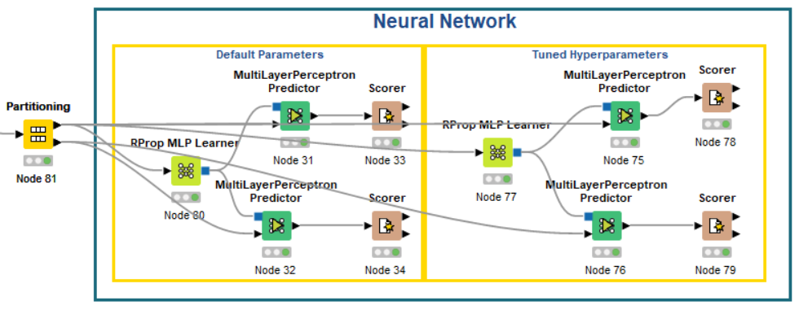
Model Building- Neural Network
A neural network is a type of machine learning algorithm that is
designed to simulate the behavior of the human brain.
It consists of layers of interconnected nodes (also called neurons) that
process and transforms data, ultimately producing an output.
Neural networks are commonly used in tasks such as image
recognition, speech recognition, and natural language processing.
data, ultimately producing
an output. Neural networks are commonly used in tasks
such as image recognition, speech recognition, and natural
language processing.

Slide 15
Model Evaluation- Neural Network Neural Network without Pruning: contains all the connections between neurons and does not undergo any pruning. Neural Network without Pruning: Neural Network without Pruning
TRAIN |  | Predicted
 |  | 1 | 0
Actual | 1 | 18(TP) | 156(FN)
 | 0 | 6(FP) | 3397(TN)
TRAIN |  | Predicted
 |  | 1 | 0
Actual | 1 | 16(TP) | 158(FN)
 | 0 | 3(FP) | 3401(TN)
TRAIN |  | Predicted
 |  | 1 | 0
Actual | 1 | 1(TP) | 74(FN)
 | 0 | 6(FP) | 1452(TN)
TRAIN |  | Predicted
 |  | 1 | 0
Actual | 1 | 1(TP) | 74(FN)
 | 0 | 3(FP) | 1455(TN)
 | Accuracy | Recall | Precision | F1 Score
Train | 95.55% | 99.8% | 95.6% | 97.7%
Test | 94.8% | 99.6% | 95.2% | 97.3%
 | Accuracy | Recall | Precision | F1 Score
Train | 95.5% | 99% | 95.6% | 97.7%
Test | 95% | 99.8% | 95.2% | 97.4%

Slide 16
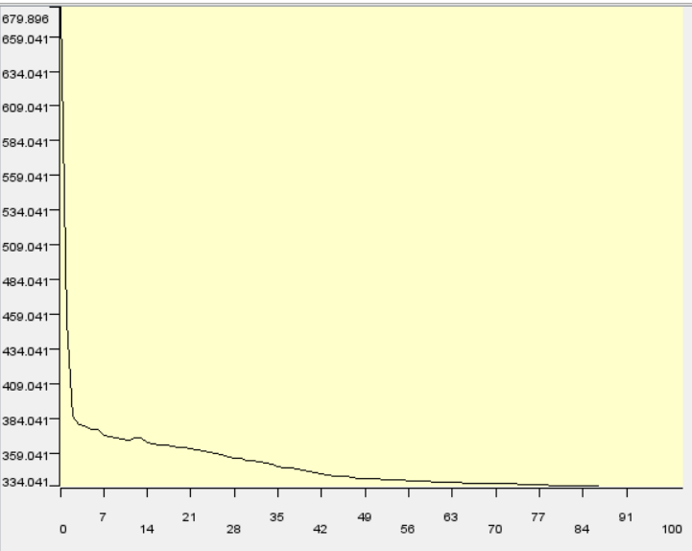
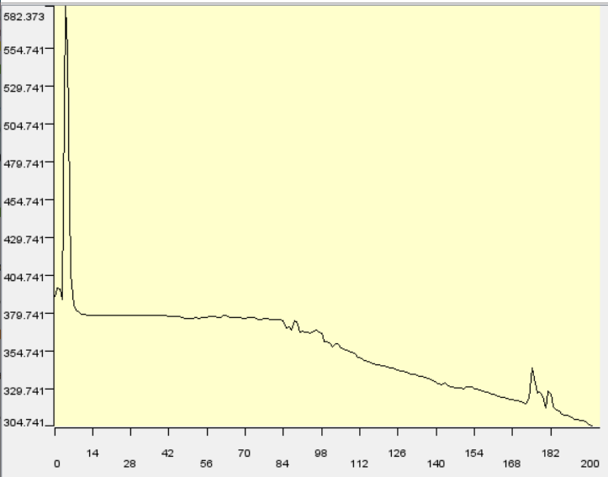
Model Building - Neural Network Classification Model Evaluation - Error Plot

Slide 17
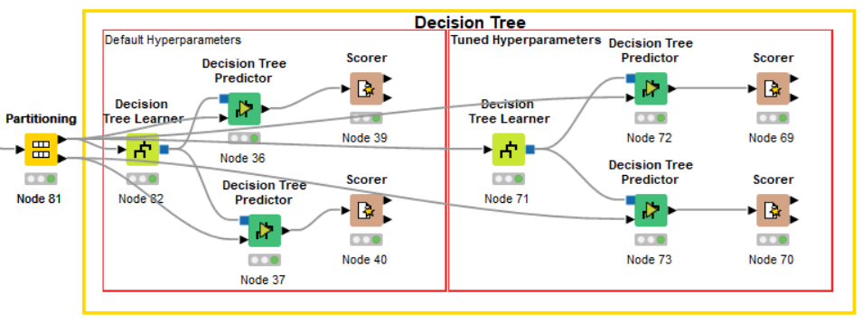
Model Building-Decision Tree
It is a tree-like model of decisions and their possible consequences.
A decision tree is made up of nodes
and branches.
The nodes represent decision points,
while the branches represent the possible
outcomes or consequences of those decisions.

Slide 18
Model Evaluation-Decision Tree
Neural Network without pruning Neural Network with Pruning
TRAIN |  | Predicted
 |  | 1 | 0
Actual | 1 | 125(TP) | 49(FN)
 | 0 | 24(FP) | 3379(TN)
TRAIN |  | Predicted
 |  | 1 | 0
Actual | 1 | 21(TP) | 153(FN)
 | 0 | 12(FP) | 3391(TN)
TEST |  | Predicted
 |  | 1 | 0
Actual | 1 | 16(TP) | 59(FN)
 | 0 | 67(FP) | 1391(TN)
TEST |  | Predicted
 |  | 1 | 0
Actual | 1 | 3(TP) | 72(FN)
 | 0 | 6(FP) | 1542(TN)
 | Accuracy | Recall | Precision | F1 Score
Train | 98% | 99.3% | 98.6% | 98.9%
Test | 91.8% | 95.4% | 95.9% | 95.7%
 | Accuracy | Recall | Precision | F1 Score
Train | 95.4% | 99.6% | 95.7% | 97.6%
Test | 94.9% | 95.3% | 95.3% | 97.4%

Slide 19
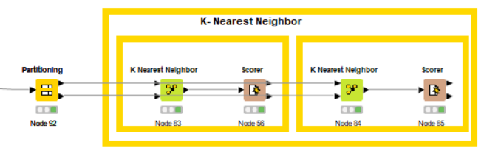
Model Building- K-Nearest Neighbor
K nearest neighbor (KNN) algorithm uses distance metrics
to predict the value of a query point based on the k closest training samples in
the feature space.
The choice of k and the distance metric can have a significant impact on
the performance of the algorithm.

Slide 20
Model Evaluation- K- Nearest Neighbor K- Nearest Neighbor without Pruning: K- Nearest Neighbor with Pruning:
K- Nearest Neighbor without Pruning K- Nearest Neighbor with Pruning
TRAIN |  | Predicted
 |  | 1 | 0
Actual | 1 | 5(TP) | 70(FN)
 | 0 | 8(FP) | 1440(TN)
TRAIN |  | Predicted
 |  | 1 | 0
Actual | 1 | 22(TP) | 152(FN)
 | 0 | 0(FP) | 3403(TN)
TRAIN |  | Predicted
 |  | 1 | 0
Actual | 1 | 22(TP) | 152(FN)
 | 0 | 0(FP) | 3403(TN)
TRAIN |  | Predicted
 |  | 1 | 0
Actual | 1 | 22(TP) | 152(FN)
 | 0 | 0(FP) | 3403(TN)
 | Accuracy | Recall | Precision | F1 Score
Train | 94.3% | 99% | 95.2% | 97.1%
Test | 94.2% | 100% | 95.1% | 97.5%
 | Accuracy | Recall | Precision | F1 Score
Train | 94.3% | 99% | 95.2% | 97.1%
Test | 94.2% | 100% | 95.1% | 97.5%

Slide 21

Thank You

